Slide 1
Vascular diseases
Department of Ophthalmology of GBOU VPO OrGMA of the Ministry of Health of the Russian Federation
Head of the Department – doct.habil. Aprelev A.E.
Lecturer – doct.habil., professor Chuprov A.D.
OrSMU

Slide 2
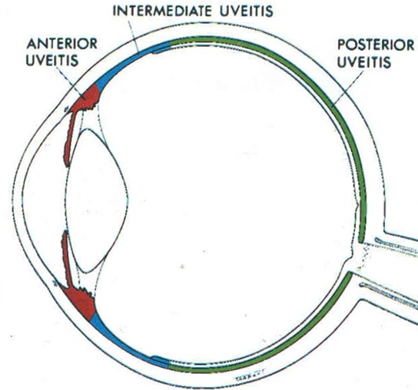
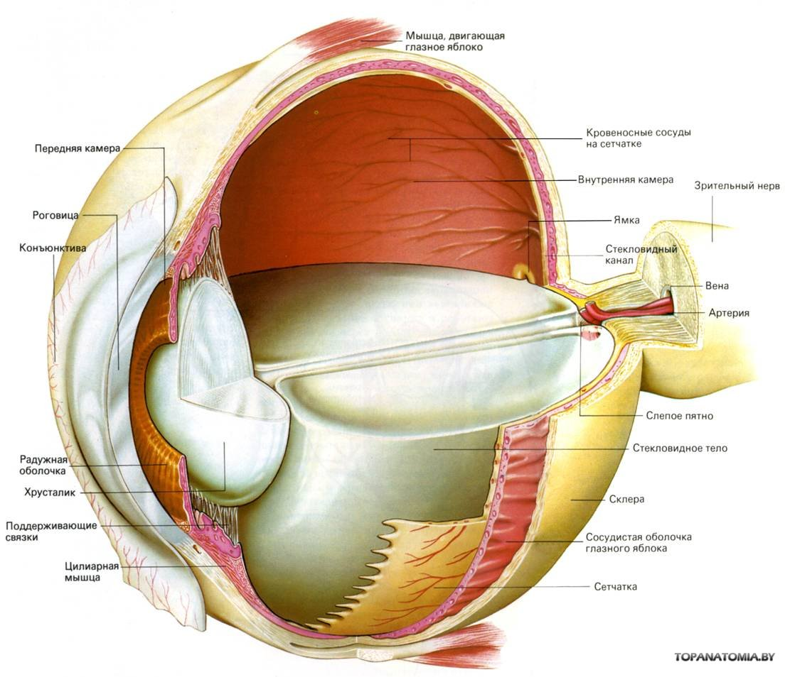
VASCULAR MEMBRANE MORPHOLOGY
✓
Iris
Ciliary body
Vascular membrane
✓
✓
OrSMU

Slide 3
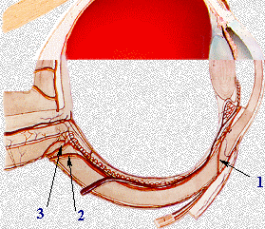
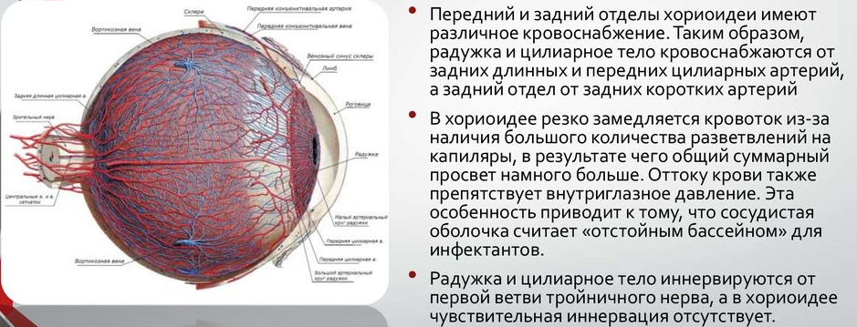
Blood supply and vascular tract innervation
1 – Anterior Ciliary Arteries (CA)
2 – Long posterior CA
3 – Short posterior CA
The anterior and posterior choroidal segments have different blood supply. Thus, iris and ciliary body are supplied from the posterior long and anterior ciliary arteries, and the posterior segment – from short posterior arteries.
In the choroid, blood flow sharply slows down due to the presence of a large number of capillary branches, as a result of which the total opening is much larger. Blood outflow is also hindered by intraocular pressure. This feature leads to the fact that vascular membrane is considered a “catch basin” for infectants.
The iris and ciliary body are innervated from the first branch of the trigeminal nerve, and there is no sentient innervation in the choroid.
Двигательная иннервация
дилататор зрачка – симпатическая из верхнешейного сплетения
сфинктер зрачка – парасимпатическая (в составе глазодвигательного III пара
OrSMU

Slide 4
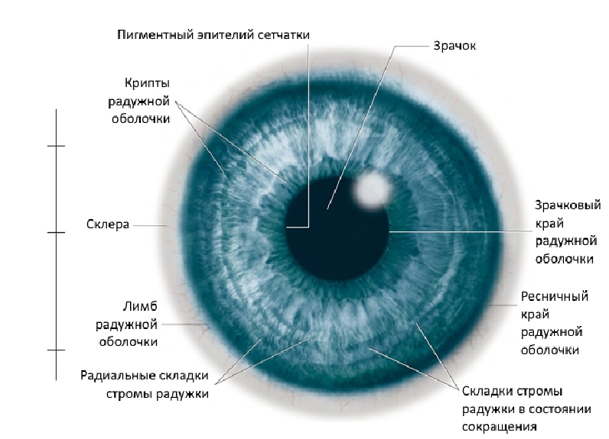
IRIS
Pupil
Retinal pigment epithelium
Iris crypts
Sclera
Pupilar margin of iris
Ciliary border of iris
Iris limb
Radial iris stroma folds
Contracted iris stroma folds
OrSMU

Slide 5
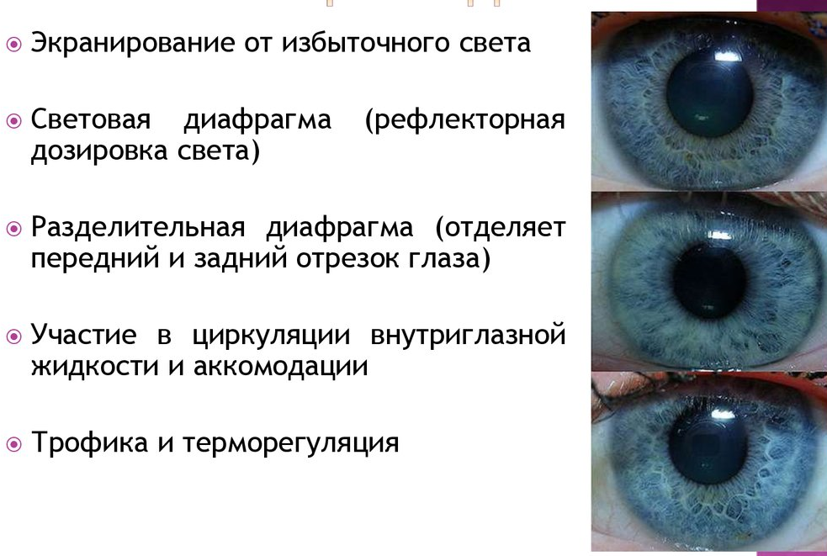
IRIS FUNCTIONS
Shielding from the excess light
Light diaphragm (reflex dosage of light)
Separating diaphragm (separates the anterior and posterior eye segments)
Participation in the intraocular fluid circulation and accommodation
Trophism and thermoregulation
OrSMU

Slide 6
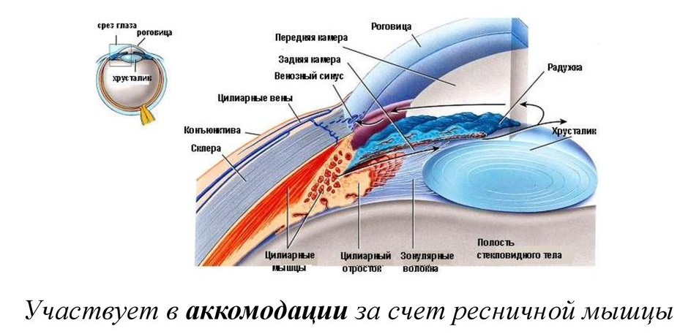
CILIARY BODY
Cross section
Cornea
Anterior chamber
Cornea
Posterior chamber
Iris
Lens
Venous sinus
Ciliary veins
Conjunctiva
Lens
Sclera
Ciliary process
Zonular fibers
Vitreous cavity
Ciliary muscles
Participates in accommodation due to ciliary muscle
process part (70 - 80 processes)
flat part (muscles with meridional, circular, tangential direction of the fibers)
OrSMU

Slide 7
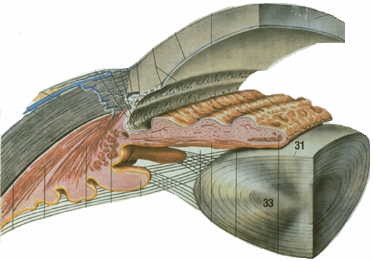
CILIARY BODY
Ciliary body is ring-shaped, 5-6mm wide, it consists of two layers – muscle (ciliary muscle) and vascular.
Ciliary muscle in its turn consists of 4 fascicles of smooth muscle fibers with different directions:
meridial fibers (Brücke's muscle),
radial (Ivanov’s muscle),
circular muscle fibers (Müller’s muscle),
iridal fibers (Kalanzas muscle).
K
I
M
B
OrSMU

Slide 8
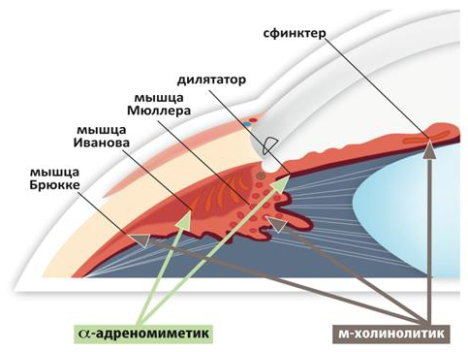
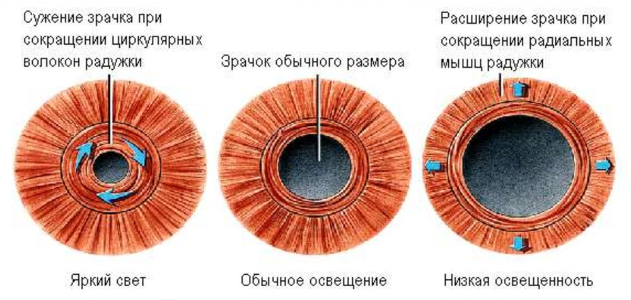
CILIARY BODY FUNCTIONS
constrictor
dilatator
Müller’s muscle
Ivanov’s muscle
Brücke’s muscle
Sympathicus
Parasympaticus
Pupil contraction with contraction of iris circular fibers
Regular pupil
Pupil dilation with contraction of iris
radial muscles
Glare
Regular light
Low light conditions
Intraocular fluid production
Participation in the act of accommodation
OrSMU

Slide 9
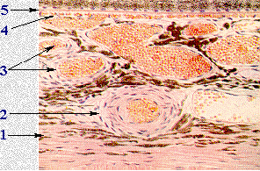
CHOROID
1 – Suprachoroidal layer
2 – Large vessels layer
3 – Medium and minute vessels layer
4 – Choriocapillary layer
5 – Vitreous table
OrSMU

Slide 10
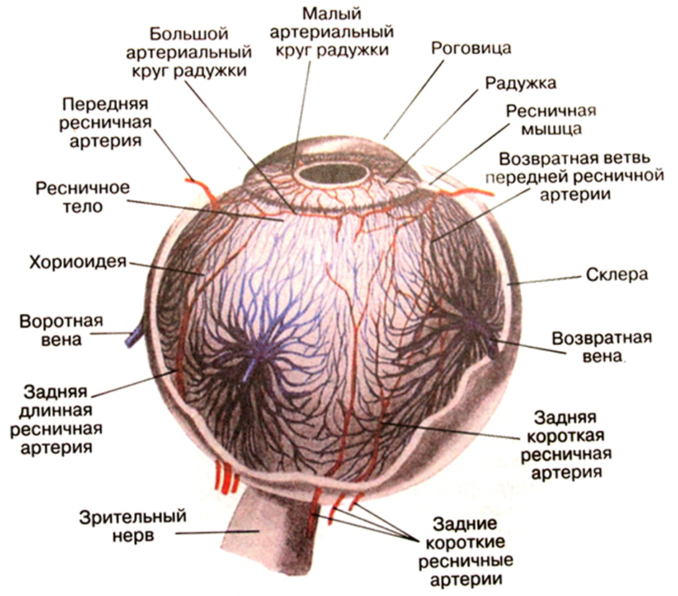
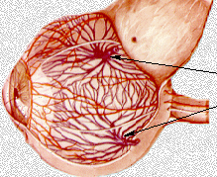
venous outflow
Lesser arterial circle of the iris
Major arterial circle of the iris
Cornea
Anterior ciliary artery
Iris
Ciliary muscle
Return strand of anterior ciliary arteries
Ciliary body
Choroid
Sclera
Portal vein
Return vein
Posterior long ciliary artery
Posterior short ciliary artery
Optic nerve
Posterior short ciliary arteries
Venous outflow from the choroid and partly from the iris and ciliary body is carried out through the vorticose veins
OrSMU

Slide 11
Anatomical features of the vascular tract
✓
Relatively isolated blood supply to the anterior (iris and ciliary body) and posterior (choroid) segments of the vascular tract, communication between the segments through the recurrent arteries
Underdeveloped innervation of the ciliary body in young children
Lack of sentient innervation of the choroid
✓
✓
OrSMU

Slide 12
ICD-10 CLASSIFICATION
Disorders Of Choroid And Retina (H30-H36)
1
Inflammatory diseases.
Dystrophic.
Neoplasms - benign and malignant.
Traumatic injury.
Congenital abnormalities of the vascular tract
2
3
4
5
OrSMU

Slide 13
INFLAMMATORY DISEASES
Inflammatory diseases of the vascular tract
✓
Anterior uveitis (iritis and iridocyclitis) - inflammation of the iris and ciliary body
Posterior uveitis (choroiditis) - inflammation of the choroid
Peripheral uveitis - inflammation of the flat part of the ciliary body and the extreme periphery of the choroid
Panuveitis - inflammation of all parts of the vascular tract
✓
✓
✓
OrSMU

Slide 14
etiologically uveitis (inflammatory disease of the vascular tract) may be:
✓
Endogenous:
Metastatic (granulomatous) - tuberculosis, syphilis, toxoplasmosis, brucellosis, leprosy
Non-metastatic (granulomatous) - influenza, tonsillitis, collagenosis, diabetes
Exogenous :
Post-traumatic
Postoperative
In deep keratitis
✓
OrSMU

Slide 15
iridocyclitis By the nature of inflammation
✓
Serous
Fibrinous-plastic
Pyogenic
Haemorrhagic
Combined
✓
✓
✓
✓
OrSMU

Slide 16
Clinical manifestations of iridocyclitis (anterior uveitis)
✓
Photophobia
Lacrimation
Blepharospasm (reflex nerve irritation)
Pain (mostly at night)
Decreased visual function
Ciliary pain on palpation
Ophthalmotonus disorder
✓
✓
✓
✓
✓
✓
OrSMU

Slide 17
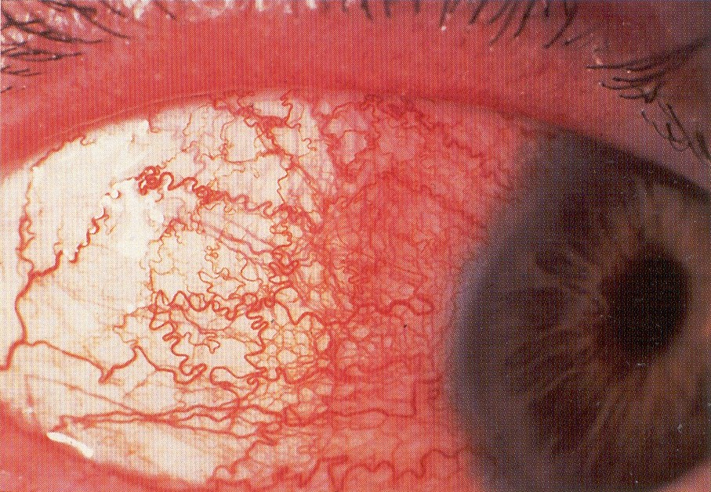
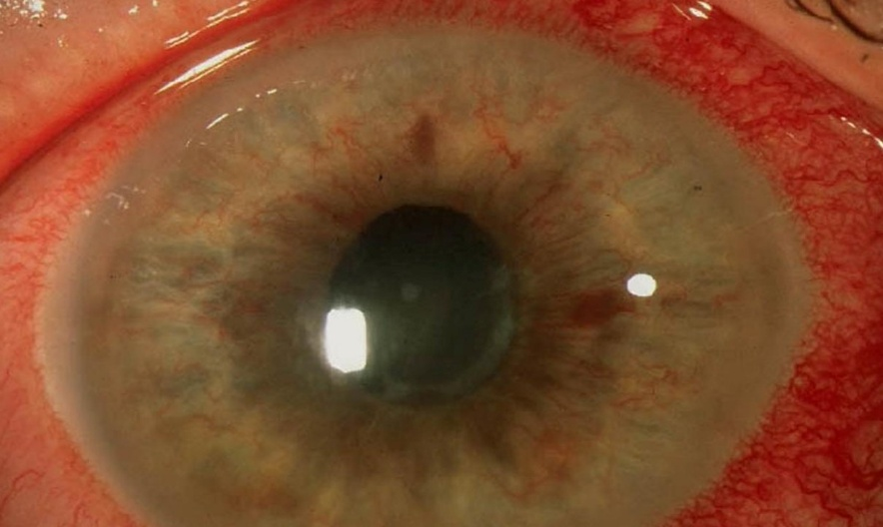
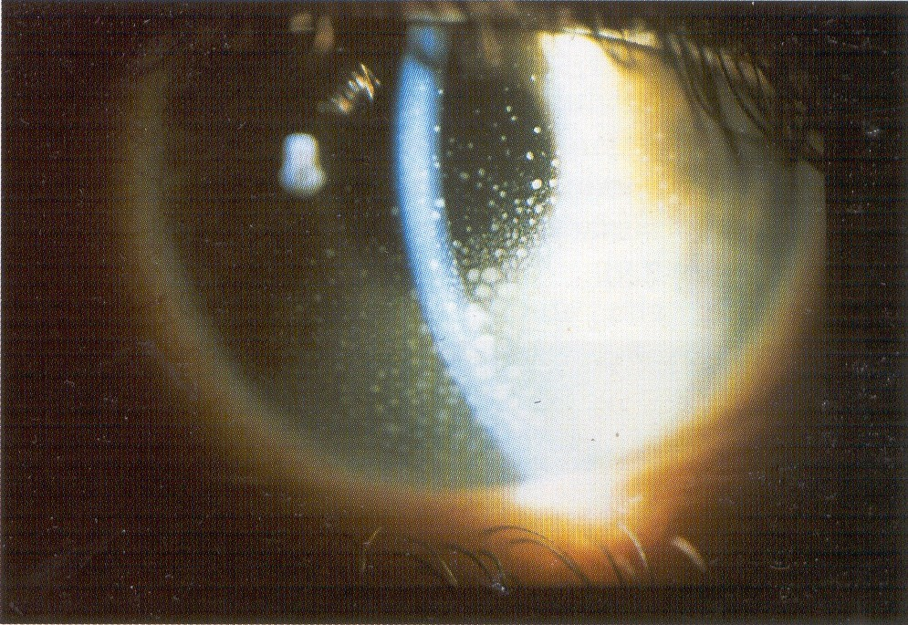
Clinical manifestations of iridocyclitis
Pericorneal or mixed injection
Precipitates on corneal endothelium
OrSMU

Slide 18
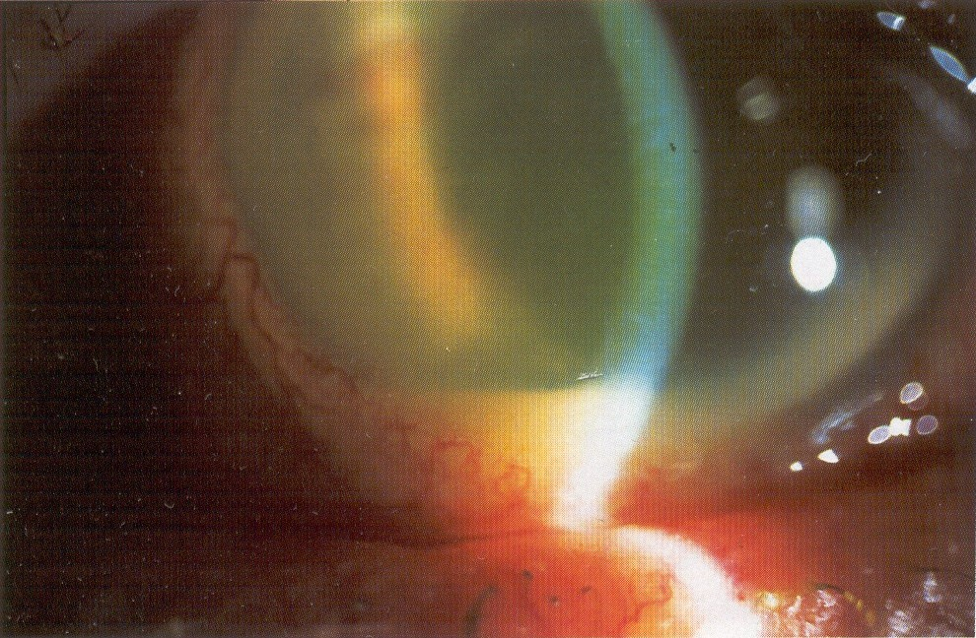
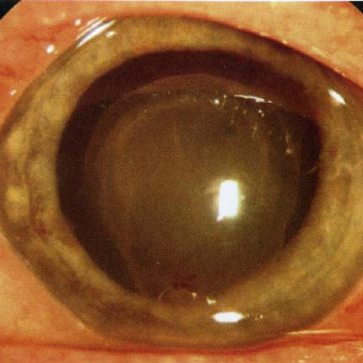
Clinical manifestations of iridocyclitis
Clouding of moisture in the anterior chamber (hypopion)
OrSMU

Slide 19
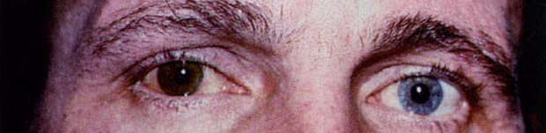
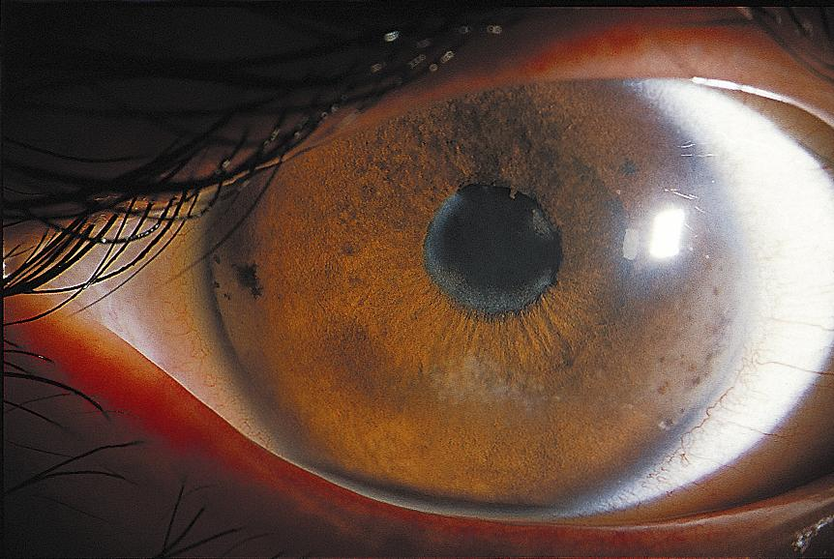
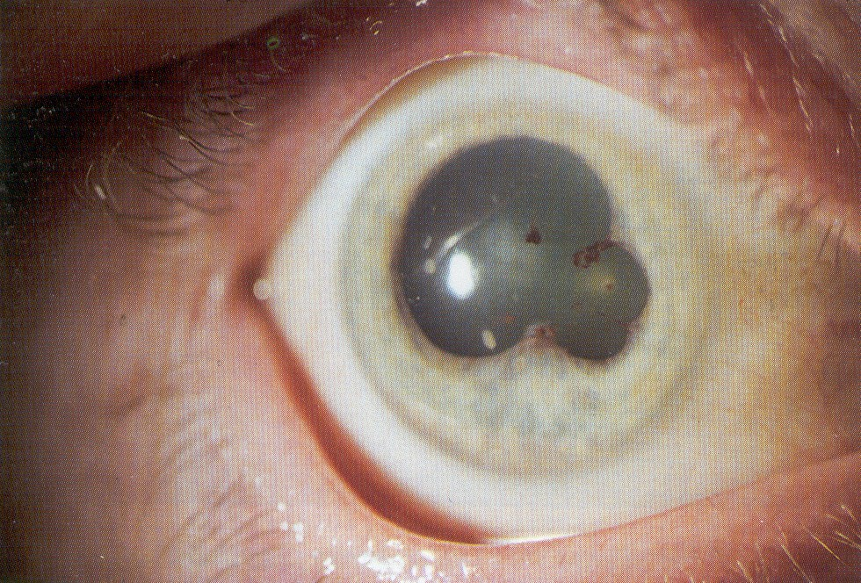
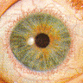
Clinical manifestations of iridocyclitis
Heterochromia iridis
Posterior synechiae
Pupil contraction
OrSMU

Slide 20
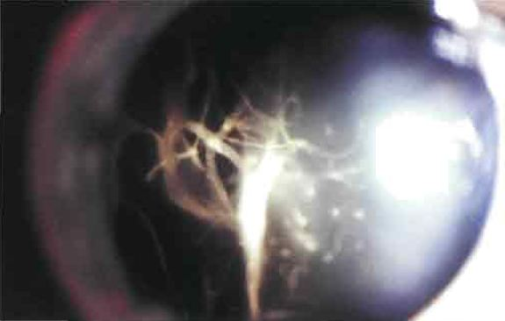
Clinical manifestations of iridocyclitis
Changes in the vitreous body
OrSMU

Slide 21
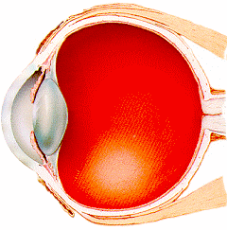
Classification of Choroiditis (Chorioretinitis)
1 – Central
2 – Paracentral
3 – Equatorial
4 – Peripheral
5 – Patchy
6 – Disseminated
1
2
4
3
OrSMU

Slide 22
CLINICAL MANIFESTATIONs oF chorioretinitis
✓
Visual impairment
Metamorphopsia
Photopsia
Scotoma (absolute, relative)
Color Disorder
✓
✓
✓
✓
OrSMU

Slide 23
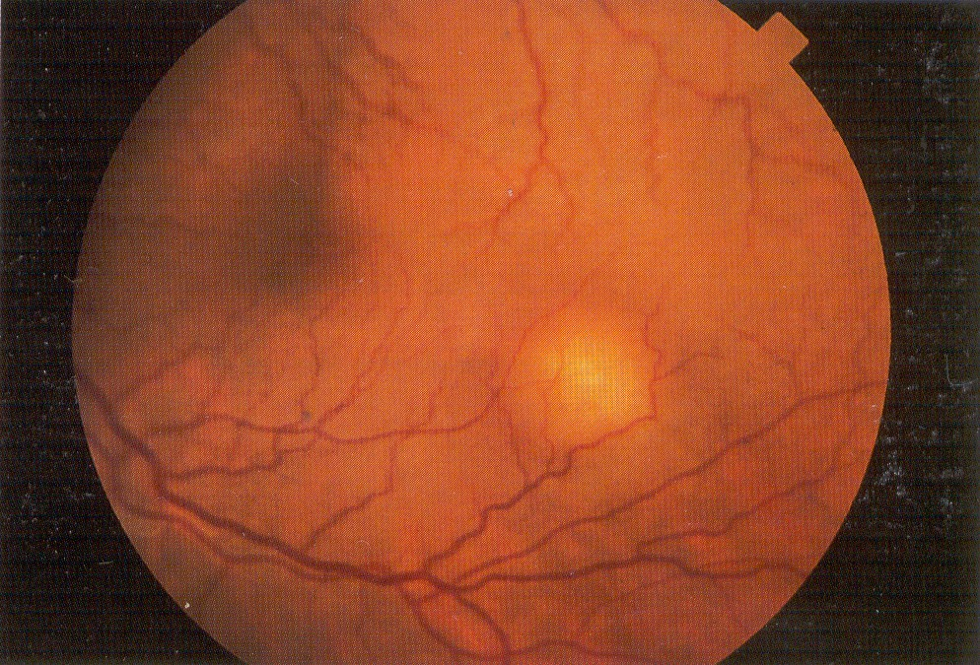
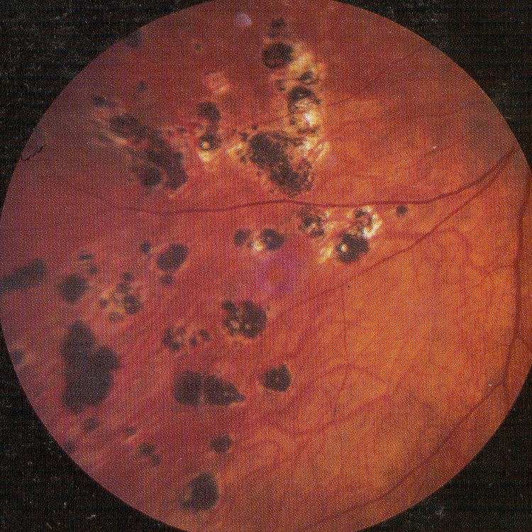
Central chorioretinitis
Active site
Outcome
OrSMU

Slide 24
anterior uveitis Complications
✓
Deep keratitis
Sclero - uveitis
Secondary glaucoma
Iris vascularization
Complicated cataract
✓
✓
✓
✓
OrSMU

Slide 25
Posterior uveitis complications
✓
Partial atrophy of the optic disc
Cystic degeneration
Vitreous hemorrhage
Vitreous opacification
Vitreous mooring
Complicated cataract
Retinal vascular lesions (retinovasculitis, periphlebitis, CAC obstruction)
✓
✓
✓
✓
✓
✓
OrSMU

Slide 26
General principles for the diagnosis of uveitis
(iridocyclitis, chorioretinitis)
External examination of the eyes (condition of the skin of the eyelids, conjunctiva), visometry, perimetry, examination of the pupil reaction
Intraocular pressure measurement (tonometry)
Biomicroscopy
Gonioscopy
Ophthalmoscopy
Eye Ultrasonography
Angiography of retinal vessels, optical coherence tomography of the macula and optic disc, laser scanning tomography of the retina
Additionally, with uveitis of various etiologies, a consultation with TB specialist or rheumatologist may be required
OrSMU

Slide 27
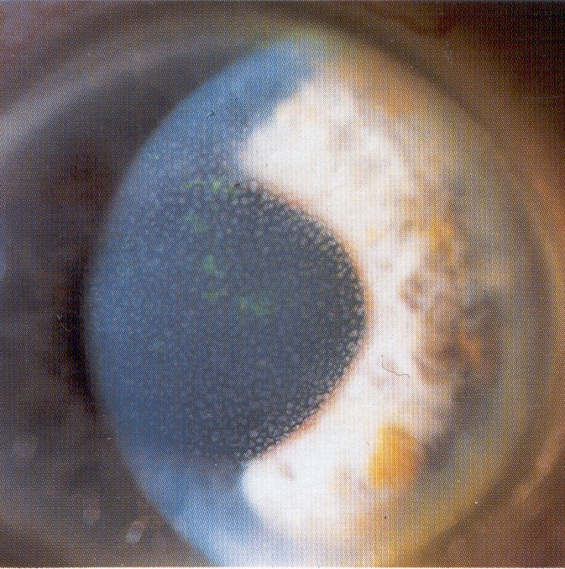
nongranulomatous iridocyclitis
Collagen diseases
The process is often bilateral
Lots of fast-breaking synechiae
More often with hypopyone
Minor precipitates
Gentle opacification of the vitreous body
The disease course is acute, frequent relapses in one eye, sometimes at the stage of exacerbation of the process in the joints
Retinovasculitis
OrSMU

Slide 28
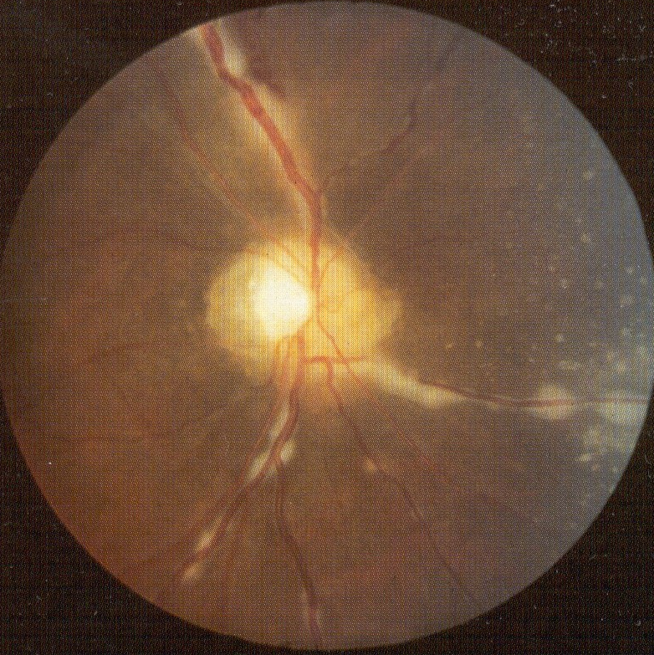
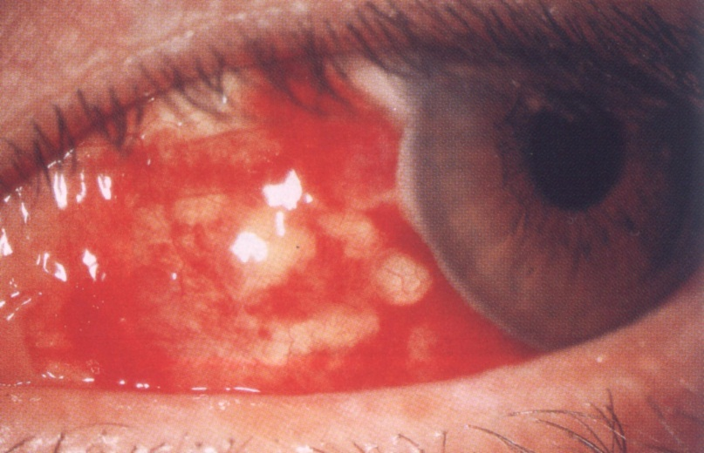
Non-granulomatous iridocyclitis
OrSMU

Slide 29
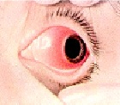
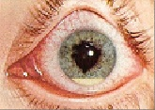
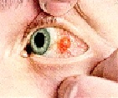
COLLAGENOSES
Rheumatism is manifested with:
episcleritis,
scleritis,
keratitis,
iridocyclitis
OrSMU

Slide 30
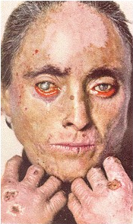
COLLAGENOSES systemic lupus erythematosus (SLE)
Changes in conjunctiva vessels (arteries narrowing, venous dilation, ampoule-like expansion of the vessels of the limbus, expansion of the vessels of the marginal loop)
Damage to the eyelids - erythematous rash, blepharitis
Conjunctivitis, episiscleritis, corneal ulcer, uveitis (iridocyclitis, panuveitis, retinovasculitis)
Retrobulbar neuritis with optic atrophy outcome
Toxic immune complexes and effector cells circulating in the blood affect microvasculature, in which hypersensitivity reactions and multisystemic failure occur.
OrSMU

Slide 31
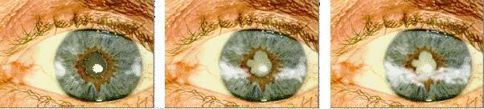
Still's Syndrome
✓
Juvenile chronic polyarthritis + lymphadenopathy + splenomegaly
CBC : anemia, leukocytosis, ESR acceleration
Chronic iridocyclitis
Lenticular degeneration of the cornea, in the form of corneal stripes
Complicated cataract
Both eyes are affected and the prognosis is poor.
✓
✓
✓
✓
✓
OrSMU

Slide 32
Behcet's Syndrome
It is characterized by inflammatory processes in the vascular layer that destroy the vessels, which provokes ischemia of the bloodstream system, as well as organ tissue cells.
(ophthalmo-stomato-genital syndrome, Adamantiades-Behcet's disease, Silk Road disease,1973)
✓
Mucosal ulcers
Genital ulcers
Uveitis with hypopion
✓
✓
OrSMU

Slide 33
Stages of eye damage in Behcet's disease
✓
Prodromal - systemic manifestations of the disease without inclusion of the eye in process;
Initial - symptoms of iridocyclitis with minimal damage to the fundus;
Medium - choroidal and retinal manifestations of the disease along with inflammatory changes in the anterior segment;
Advanced - progressive chorioretinal degeneration with sharply reduced visual acuity as a result of damage to the macula;
Terminal – cicatrical changes of the retina, blindness due to optic atrophy, retinal detachment and secondary glaucoma.
✓
✓
✓
✓
OrSMU

Slide 34
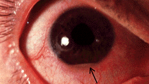
Hypopion, uneven pupil, eyeball injection
OrSMU

Slide 35
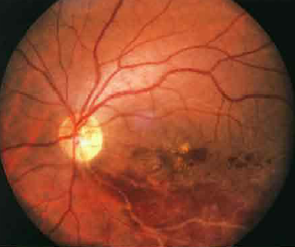
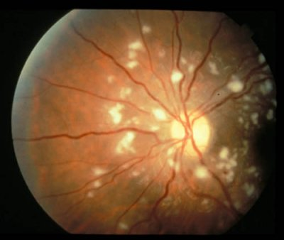
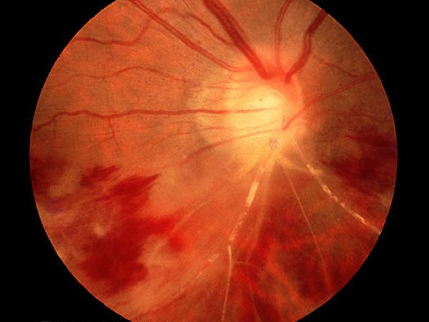
✓
Severe posterior uveitis or panuveitis, with intraocular hemorrhages, retinal edema, severe retinovasculitis
OrSMU

Slide 36
complications
✓
Tapelike corneal degeneration
Complicated cataract
Secondary glaucoma
Opacity and fibrosis of the vitreous body
Vasculitis with occlusion and the development of retinal infarction
Exudative retinal detachment
Optic neuritis and atrophy
✓
✓
✓
✓
✓
✓
OrSMU

Slide 37
Reiter's Disease
(Reiter syndrome, Fissenge-Leroy syndrome, urethro-oculo-synovial syndrome)
The classic triad is urethritis, conjunctivitis, arthritis. + mucosal and skin lesions
A mixed infection is considered to be the causative factor of Reiter’s disease (RD): chlamydial, mycoplasma, salmonella, yersiniosis, trichomonas, gonorrhea, etc.
OrSMU

Slide 38
2 VARIATIONS
Sporadic is a lesion of the genitourinary tract in the form of: urethritis, prostatitis, less often - epididymitis, orchitis in men; endocervicitis, follicular erosion of the cervix, adnexitis, salpingitis - in women. Etiology of inflammation of Chlamydia thrahomatis, less commonly Ureaplasma hominis, Micoplasma Henitalium, mycoplasma.
Epidemic - after intestinal infection caused by Shigella Flexneri, Yersinia enterocolitica, Salmonella thyphymurium
✓
✓
OrSMU

Slide 39
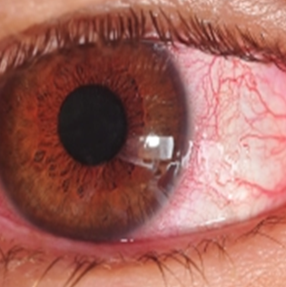
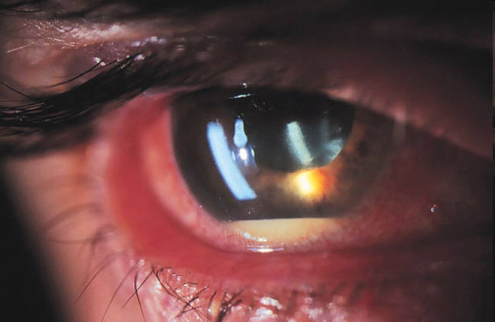
Eye manifestations in Reiter's syndrome
✓
Conjunctivitis (short-lasting and mild)
Less often – iritis
Uveitis
Iridocyclitis (acute with precipitates on the corneal endothelium, with exudate in the anterior chamber, sometimes even purulent and hemorrhagic)
Retinitis
Optic neuritis
✓
✓
✓
✓
✓
OrSMU

Slide 40
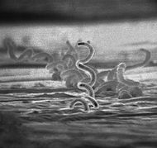
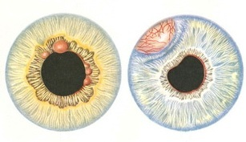
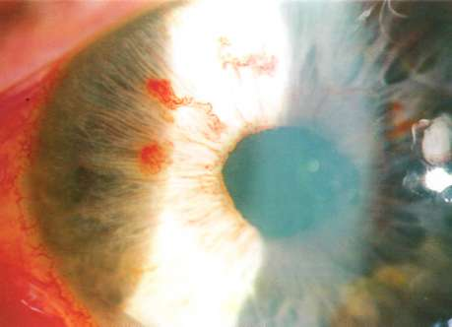
Syphilitic uveitis
✓
Roseolous, papular iridocyclitis
Diffuse iridocyclitis
Diffuse central chorioretinitis
Peripheral Chorioretinitis
✓
✓
✓
280-315 people per 100 thousand people
OrSMU

Slide 41
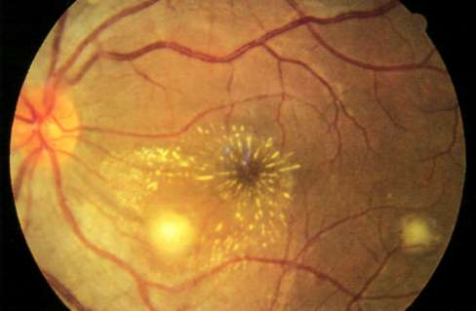
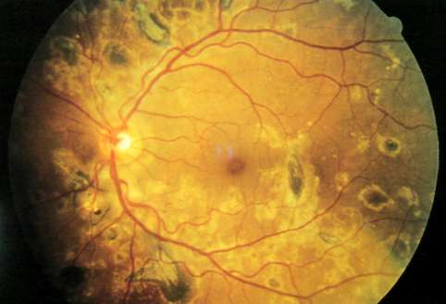
Syphilitic uveitis
OrSMU

Slide 42
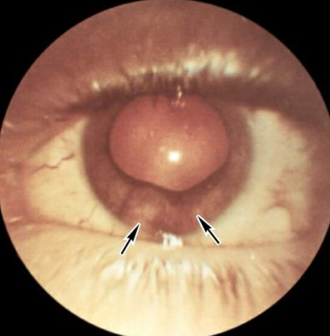
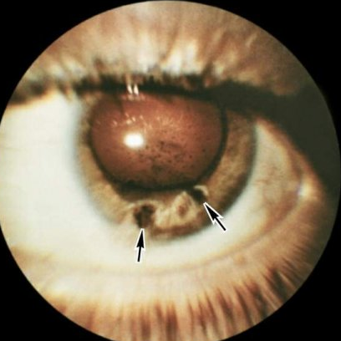
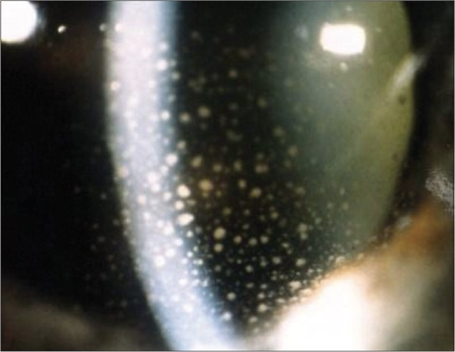
tuberculous uveitis увеит
✓
Tubercular iridocyclitis
Diffuse iridocyclitis
Choroiditis (solitary granuloma, differential diagnosis with a tumor)
✓
✓

Slide 43
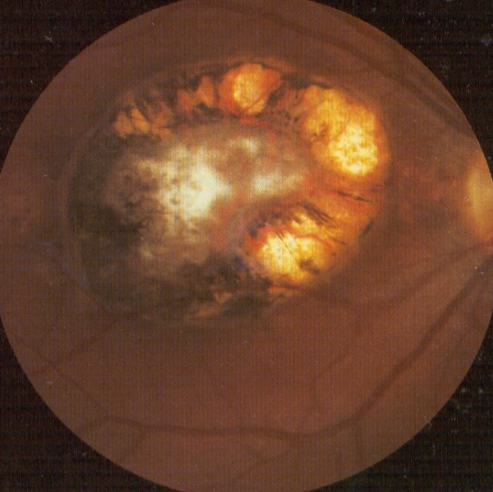
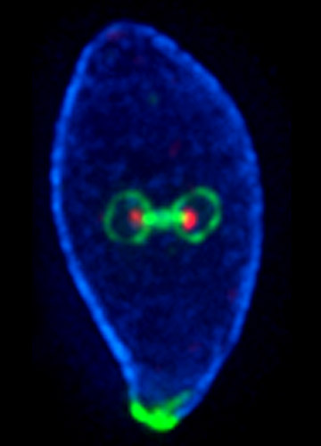

Toxoplasma uveitis
✓
Chloridine or Daraprim, Thindurin
Sulfathiazole with corticosteroids and folic acid
Spiramycin, chlortetracycline, lincomycin
✓
✓
OrSMU

Slide 44


Toxoplasma uveitis
OrSMU

Slide 45



Toxoplasma uveitis
OrSMU

Slide 46
Toxoplasma diagnostics
✓
Toxoplasmin skin tests
Saybin Feldman's reaction
CFT
Indirect hemagglutination reaction
Immunofluorescence Reaction
Labeled antibody enzyme (in serum and anterior chamber moisture)
✓
✓
✓
✓
✓
OrSMU

Slide 47
leprosy
Causative agent - Mycobacterium leprae has tropism to the skin, peripheral nervous system and the anterior segment of the eye. Airborne or skin damage transmitted. Diagnosis: microscopic and histological examination of the skin, PCR.
Acute iritis – the effect of immune complexes on the iris, local treatment with steroids.
Chronic iritis – invasion of bacilli with the development of neuroparalytic inflammation with damage to the nerves of the iris.
The pathognomonic sign is the formation of small, shiny "pearls" along the pupil edge, then they increase, fall into the anterior chamber and disappear.
OrSMU

Slide 48



leprosy
OrSMU

Slide 49


leprosy (manifestations and outcomes)
Madarosis, trichiasis, conjunctivitis, episiscleritis, keratitis, scleritis.
Myosis and iris atrophy in chronic lepromatous iritis
Trichiasis, lagophthalmus (paralysis and facial anesthesia due to damage to the facial and trigeminal nerves)
The development of keratitis with subsequent thorn formation

Slide 50
General principles for the treatment of uveitis
(iridocyclitis, chorioretinitis)
Midriatics,
Steroids,
Systemic immunosuppressive drugs;
In case of uveitis of infectious etiology - antimicrobial and antiviral agents,
In case of systemic diseases – NASID, cytostatics,
With allergic lesions - antihistamines
OrSMU

Slide 51
Surgical treatment of uveitis
Paracentesis
Iridectomy: complete, basal, optical. Laser Iridectomy
Complicated cataract extraction
Retinal laser coagulation in patchy processes
Surgery for retinal detachment: traction detachment
Replacement of vitreous with solutions, gas with antibiotics
Enucleation
Evisceration
OrSMU

Slide 52

sympathetic ophthalmia
Inflammatory damage to healthy eye, which occurs against the background of an injury or other disease of the second eye. In most cases, ophthalmia occurs as anterior uveitis.
Precipitates
Posterior synechiae
Exudate in the AC
neuroretinitis
OrSMU

Slide 53
3 types of sympathetic ophthalmia
✓
Serous (serous iridocyclitis develops). It proceeds easily, and in the vast majority of cases does not affect visual acuity.
Combined (May be accompanied by optic neuritis secondary to severe plastic iridocyclitis or symblepharon). Inflammatory process of this type is more common than others. Often ends up with complete loss of vision.
Neuritic (blind spot increases, sensitivity to colors sharply decreases, photophobia develops). Pathology is rare and, as a rule, is diagnosed as an independent disease. At the beginning of neurotic sympathetic ophthalmia, characteristic symptoms are absent.
✓
✓
OrSMU

Slide 54

Clinical manifestations
uncontrolled lacrimation;
inadequate response to light;
narrowing or changing the shape of the pupil;
flashes, "flies" or bright spots in front of the eyes;
visual impairment;
pain on palpation;
hyperemia.
OrSMU

Slide 55
etiology
Causative agent affects healthy eye through the blood, that is, it has uveotropy.
Pathology is the result of weakening of the protective functions of the body, immune disorders or autoimmune allergic response.
Inflammation is associated with impaired neural trophic function.
OrSMU

Slide 56
sympathetic ophthalmia development factors
penetrating and blunt ocular trauma;
penetrating wounds and ulcers of the cornea;
ophthalmological operations;
concussions;
subconjunctival scleral rupture;
malignant tumors.
OrSMU

Slide 57
treatment
corticosteroid hormones;
antibacterial
anti-inflammatory
anti-allergic drugs (can also be recommended if removal surgery has been performed);
cytostatics
OrSMU

Slide 58


Malformations of the vascular tract
Iris coloboma
OrSMU

Slide 59


Malformations of the vascular tract
Coloboma of the choroid
OrSMU

Slide 60


Malformations of the vascular tract
Polycoria (dycoria)
OrSMU

Slide 61


Malformations of the vascular tract
Corectopia
OrSMU

Slide 62


Malformations of the vascular tract
Aniridia
OrSMU

Slide 63

Malformations of the vascular tract
Pigmented spots
OrSMU

Slide 64



Malformations of the vascular tract
Interpupillary membrane
OrSMU

Slide 65

Malformations of the vascular tract
Congenital iris heterochromia
OrSMU

Slide 66

Malformations of the vascular tract
Albinism
OrSMU

Slide 67


Thank you
for
The attention !
OrSMU

